Slide 1
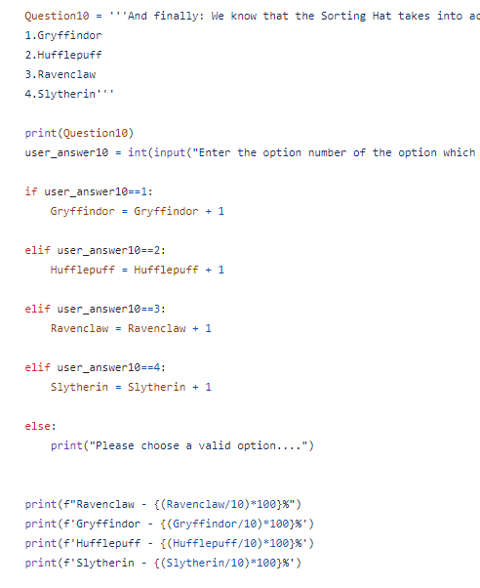
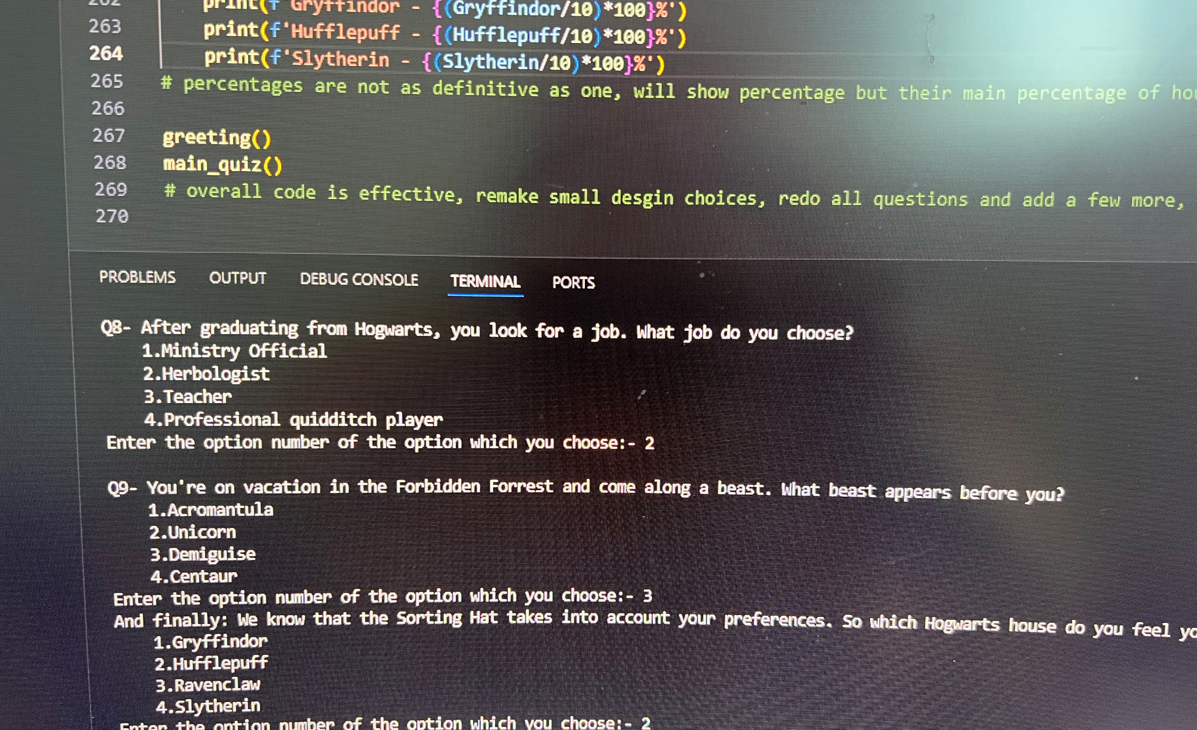
Harry Potter: A Sorting Quest by Eryn Comet Ridings
A personalized quiz that takes the user through a journey. At the end of the journey, the user will be sorted into their respected houses based on their personalized answers they chose.

